Slide 1
Timers
Siemens
© 2014 John Sefcovic.

Slide 2
Timers
A Timer delays changing the state of an output.
A Timer can delay turning Off an output.
A Timer can delay turning On an output.
A Timer can pulse On for a predetermined duration.
There are four Timer instructions.
Timer On Delay (TON)
Timer Off Delay (TOF)
Timer On Retentive (TONR)
Timer Pulse (PT)

Slide 3
Timers
The Timer Instructions controls other outputs.
The Timer begins elapsing time when the rung state changes.
The Timer uses a PRESET TIME to determine the duration of the delay.
The Timer uses an ELASPED TIME to track the duration of the timer.
The Timer uses an OUTPUT BIT to indicate when the PRESET TIME equals the ELAPSED TIME, the timer times out.
The Timer OUTPUT BIT state is used to control an output in the process or application.

Slide 4
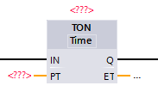
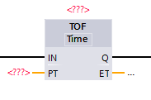
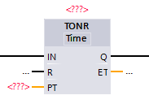
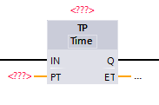
Block Timers

Slide 5
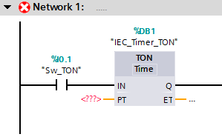
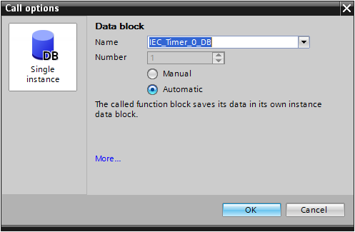
Timer IEC Data Block
When the Timer Block instruction is added to the Network rung…
… the IEC Data Block dialog opens automatically.

Slide 6
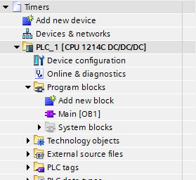
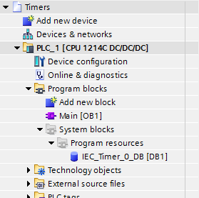
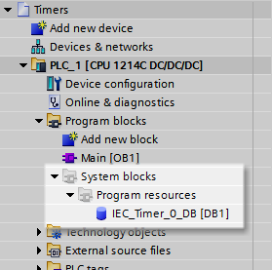
Timer IEC Data Block
The IEC_Timer_Data_Block is added to the Project Tree…
… under System blocks as a Program resource.

Slide 7
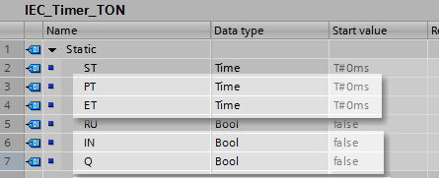
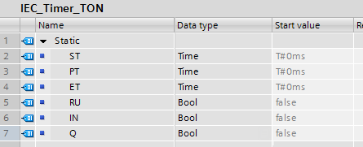
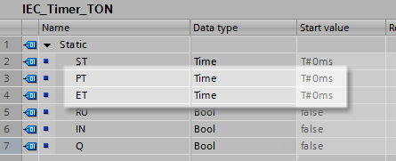
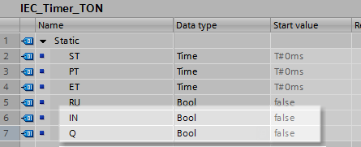
Timer IEC Data Block
The table for the IEC_Timer_Data_Block stores the Preset Time, Elapsed Time values and the In and Output Bits.
The Preset Time (PT) holds the value the timer is to delay.
The Input Bit (IN) reflects the Result of Logic Operation (RLO) preceding the instruction.
The Elapsed Time (ET) holds the current value of the timer’s delay.
The Output Bit (Q) holds the current status of the delay operation and will change at the completion of the timing cycle or preceding RLO to the instruction.

Slide 8
Timer IEC Data Block
The table for the IEC_Timer_Data_Block stores the Preset Time, Elapsed Time values and the In and Output Bits.
Preset Time is Time Data Type
Elapsed Time is Time Data Type
In Bit is a Boolean Data Type
Output Bit is a Boolean Data Type

Slide 9
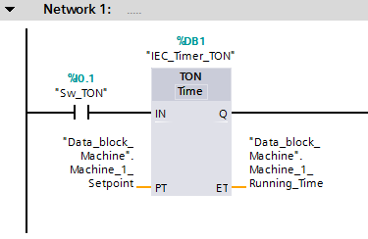
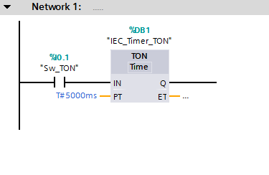
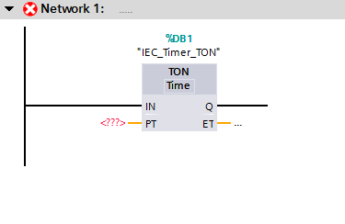
Block Timers Parameters
The added Timer will used the IEC_Data_Block.
A value must be entered for the Preset Time. It may be a Constant value or a Tag.
The Preset Time and Elapsed Time may both be assigned Tags.
The Elapsed Time is optional, but must be a Tag.

Slide 10
Timer ON
TIMER ON DELAY (TON)
The Timer On Delay (TON) is an instruction that will turn on a controlled output when the Elapsed Time is equal to the Preset Time.
The equal values will result in the Output Bit being set. The Output Bit is used to control other logic.
While the rung is true, the timer will begin to elapse at intervals of 0.001 seconds, milliseconds.

Slide 11
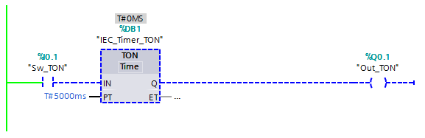
Timer ON
When the rung is FALSE, the Elapsed Time for the timer does not increment.
The Output Bit is reset, Off.

Slide 12
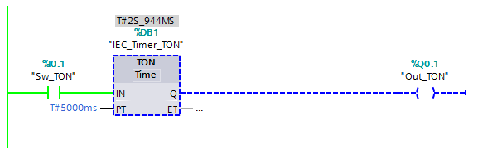
Timer ON
When the rung is TRUE, the Elapsed Time for the timer does increment.
The Output Bit is reset, Off.

Slide 13
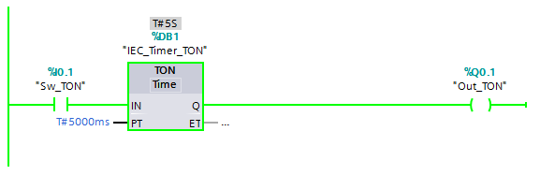
Timer ON
When the rung is TRUE, and the Elapsed Time is EQUAL to the Preset Time, the Output is set, turned ON.

Slide 14
Timer ON
When the rung returns to FALSE, the Elapsed Time and Output Bit returns to the initial settings.
Note: if at any point in the timing cycle, the rung goes FALSE, the timer returns to the initial conditions.

Slide 15
Timer OFF
TIMER OFF DELAY (TOF)
The Timer Off Delay (TOF) is an output instruction that will turn off a controlled output when the elapsed time is equal to the preset time.
The equal values will result in the Output Bit being reset. The Output Bit is used to control other logic.
While the rung is false, the timer will begin to elapse at intervals of 0.001 seconds, milliseconds.

Slide 16
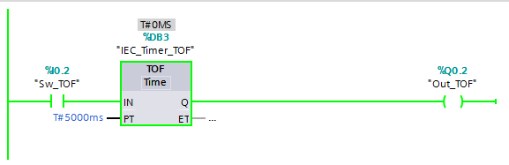
Timer OFF
When the rung is TRUE, the Elapsed Time value for the timer does not increment.
The Output Bit is set, On.

Slide 17
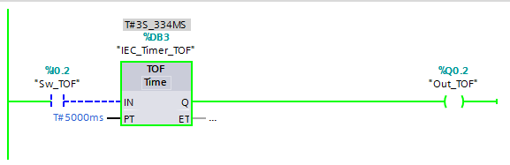
Timer OFF
When the rung is FALSE, the Elapsed Time value for the timer does increment.
The Output Bit is set, On.

Slide 18

Timer OFF
When the rung is FALSE, and the Elapsed Time value is EQUAL to the Preset Time, the Output Bit is reset, turned OFF.

Slide 19
Timer OFF
When the rung returns to TRUE, the Elapsed Time and Output Bit returns to the initial settings.
Note: if at any point in the timing cycle, the rung goes TRUE, the timer returns to the initial conditions.

Slide 20
Timer ON Retentive
TIMER ON RETENTIVE DELAY (TONR)
A Timer On Retentive (TONR) is similar to the Timer On Delay. The difference is the Timer On Retentive will retain its Elapsed Time when the rung is false. When the rung is true, the Elapsed Time will increment from the current value.
When the Elapsed Time and Preset Time are equal, the Output Bit is set.

Slide 21
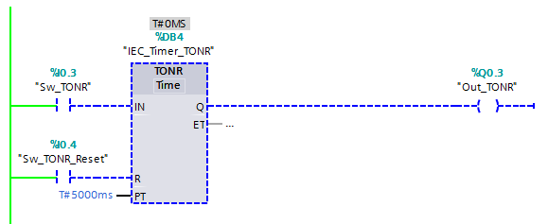
Timer ON Retentive
Similar to the Timer On Delay, the Timer On Retentive (TONR) when the rung is FALSE the Elapsed Time is at zero.
The Output Bit is reset.

Slide 22
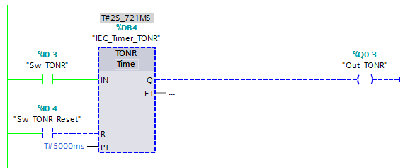
Timer ON Retentive
When the rung is TRUE the Elapsed Time is incrementing.
The Output Bit is reset.

Slide 23
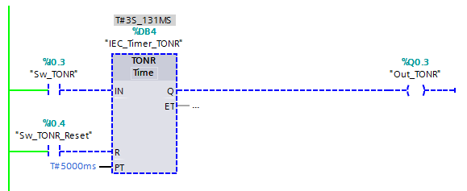
Timer ON Retentive
When the rung goes FALSE the Elapsed Time is retained.
The Output Bit remains reset.

Slide 24

Timer ON Retentive
When the rung returns to TRUE the Elapsed Time continues to increment.
The Output Bit remains reset.

Slide 25
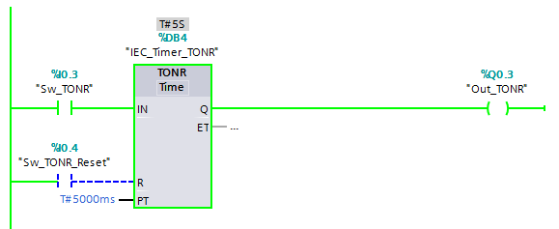
Timer ON Retentive
The Elapsed Time is EQUAL to Preset Time the elapsed value stops incrementing.
The Output Bit is set.

Slide 26
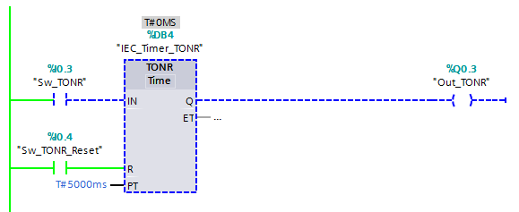
Timer ON Retentive
When the rung for the Reset goes TRUE, the Elapsed Time returns to zero.
The Output Bit is reset.

Slide 27
Timer Pulsed
TIMER PULSED (TP)
The Timer Pulsed (TP) is an instruction that will turn on a controlled output, the Output Bit is set, while Elapsed Value is incrementing. The Output Bit is used to control other logic.
When the Elapsed Time equals Preset Time, the result will be the Output Bit is reset, turned Off.
While the rung is true, the timer will begin to elapse at intervals of 0.001 seconds, milliseconds.

Slide 28

Timer Pulsed
When the rung is FALSE, the Elapsed Time for the timer does not increment.
The Output Bit is reset, Off.

Slide 29
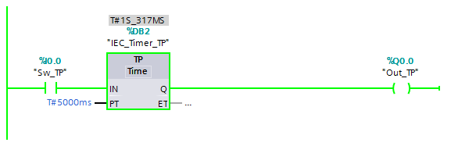
Timer Pulsed
When the rung is TRUE, the Elapsed Time for the timer does increment.
The Output Bit is set, On.

Slide 30
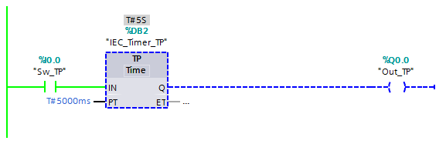
Timer Pulsed
When the rung is TRUE, and the Elapsed Time is EQUAL to the Preset Time, the Output Bit is then reset, turned OFF.
Note: the rung must go FALSE to TRUE, to reset the timer to initiate another pulsed output.

Slide 31
Timer Pulsed
When the rung returns to FALSE, the Elapsed Time and Output Bit returns to the initial settings.
Note: if at any point in the timing cycle, the rung goes FALSE, the timer returns to the initial conditions.

Slide 32
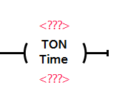
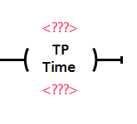
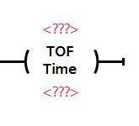
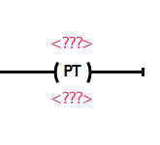
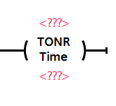
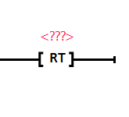
Coil Timers

Slide 33
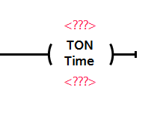
Timer IEC Data Block
When the Timer Block instruction is added to the Network rung…
The IEC Data Block must be added manually.

Slide 34
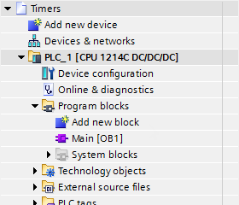
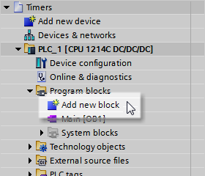
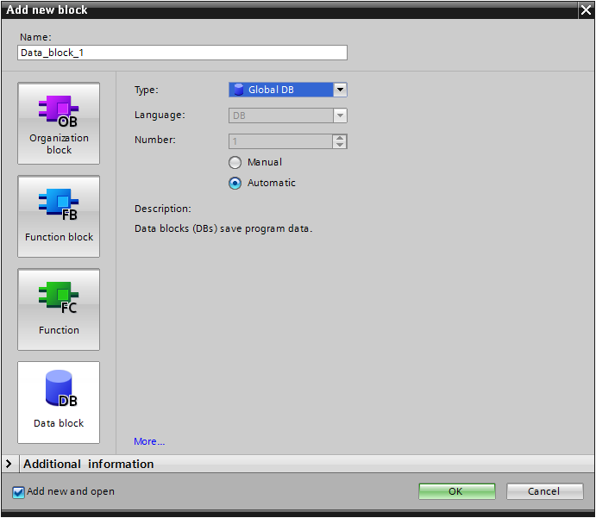

Timer IEC Data Block
The Add new block dialog appears.
In the Project Tree…
…select Add new block.
Verify Data Block is selected.

Slide 35
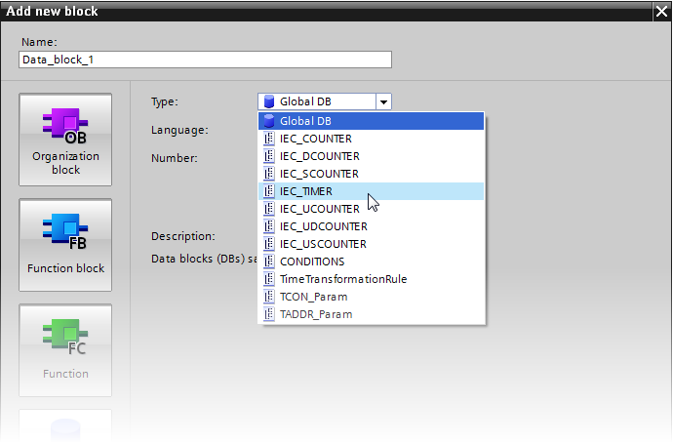
Timer IEC Data Block
In the Type: dropdown,
select:
IEC_TIMER

Slide 36
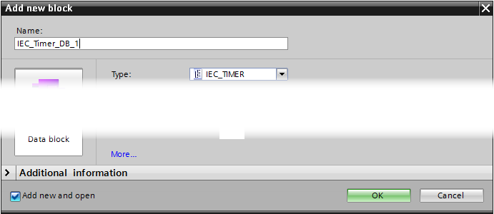
Timer IEC Data Block
Type in a Name: for the data block.
Select OK.

Slide 37
Timer IEC Data Block
The IEC_Timer_Data_Block is added to the Project Tree…
… under System blocks as a Program resource.

Slide 38
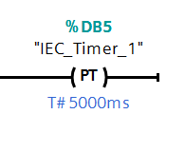
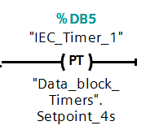
Timers Parameters
The added Timer will used the IEC_Data_Block.
A value must be entered for the Preset Time. It may be a Constant value or a Tag.

Slide 39
Timer ON
TIMER ON DELAY (TON)
The Timer On Delay (TON) is an instruction that will turn on a controlled output when the Elapsed Time is equal to the Preset Time.
The equal values will result in the Output Bit being set. The Output Bit is used to control other logic.
While the rung is true, the timer will begin to elapse at intervals of 0.001 seconds, milliseconds.

Slide 40
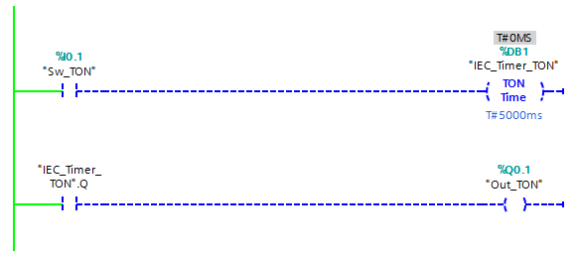
Timer ON
When the rung is FALSE, the Elapsed Time for the timer does not increment.
The Output Bit is reset, Off.

Slide 41
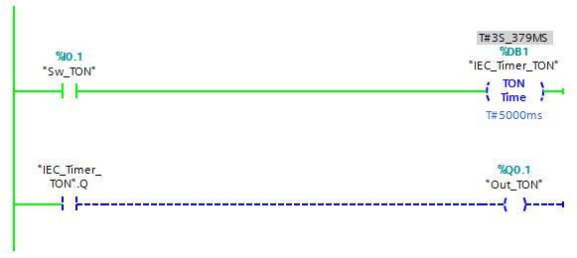
Timer ON
When the rung is TRUE, the Elapsed Time for the timer does increment.
The Output Bit is reset, Off.

Slide 42
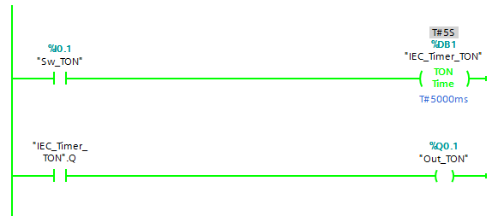
Timer ON
When the rung is TRUE, and the Elapsed Value is EQUAL to the Preset Value, the Output is set, turned ON.

Slide 43
Timer ON
When the rung returns to FALSE, the Elapsed Time and Output Bit returns to the initial settings.
Note: if at any point in the timing cycle, the rung goes FALSE, the timer returns to the initial conditions.

Slide 44
Timer OFF
TIMER OFF DELAY (TOF)
The Timer Off Delay (TOF) is an output instruction that will turn off a controlled output when the Elapsed Time is equal to the Preset Time.
The equal values will result in the Output Bit being reset. The Output Bit is used to control other logic.
While the rung is false, the timer will begin to elapse at intervals of 0.001 seconds, milliseconds.

Slide 45
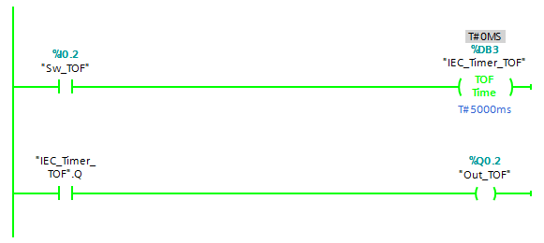
Timer OFF
When the rung is TRUE, the Elapsed Time value for the timer does not increment.
The Output Bit is set, On.

Slide 46
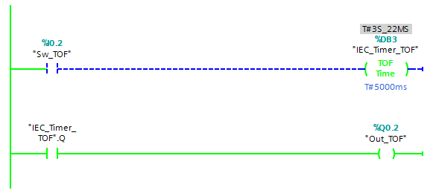
Timer OFF
When the rung is FALSE, the Elapsed Time value for the timer does increment.
The Output Bit is set, On.

Slide 47
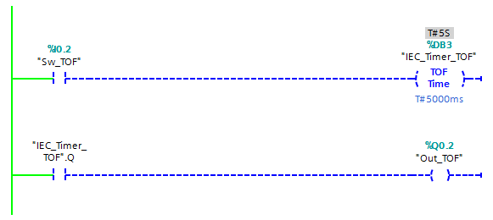
Timer OFF
When the rung is FALSE, and the Elapsed Time value is EQUAL to the Preset value, the Output Bit is reset, turned OFF.

Slide 48
Timer OFF
When the rung returns to TRUE, the Elapsed Time and Output Bit return to the initial settings.
Note: if at any point in the timing cycle, the rung goes TRUE, the timer returns to the initial conditions.

Slide 49
Timer ON Retentive
TIMER ON RETENTIVE DELAY (TONR)
A Timer On Retentive (TONR) is similar to the Timer On Delay. The difference is the Retentive Timer will retain its Elapsed Value when the rung is false. When the rung is true, the elapsed value will increment from the current value.
When the Elapsed Time and Preset Time are equal, the Output Bit is set.

Slide 50
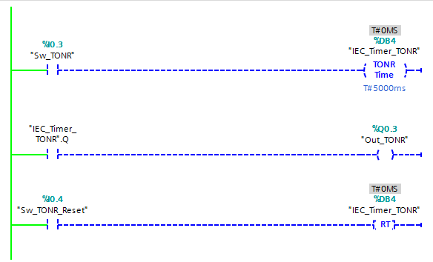
Timer ON Retentive
Similar to the Timer On Delay, the Timer On Retentive (TONR) when the rung is FALSE the Elapsed Time is at zero.
The Output Bit is reset.

Slide 51
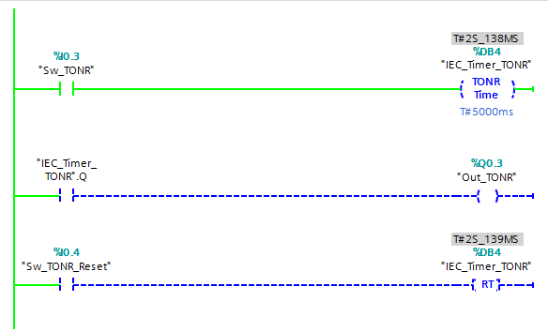
Timer ON Retentive
When the rung is TRUE the Elapsed Time is incrementing.
The Output Bit is reset.

Slide 52

Timer ON Retentive
When the rung goes FALSE the Elapsed Time is retained.
The Output Bit remains reset.

Slide 53

Timer ON Retentive
When the rung returns to TRUE the Elapsed Time continues to increment.
The Output Bit remains reset.

Slide 54

Timer ON Retentive
The Elapsed Time is EQUAL to Preset Time the elapsed value stops incrementing.
The Output Bit is set.

Slide 55

Timer ON Retentive
When the rung for the Reset (RT) goes TRUE, the Elapsed Time returns to zero.
The Output Bit is reset.

Slide 56
Reset Timer
When the rung is TRUE, the Reset (RES) instruction returns the
Timer On Retentive (TONR) with the same Tag identifier Elapsed Value to zero.

Slide 57
Timer Pulsed
TIMER PULSED (TP)
The Timer Pulsed (TP) is an instruction that will turn on a controlled output, the Output Bit is set, while Elapsed Time is incrementing. The Output Bit is used to control other logic.
When the Elapsed Time equals Preset Time, the result will be the Output Bit is reset, turned Off.
While the rung is true, the timer will begin to elapse at intervals of 0.001 seconds, milliseconds.

Slide 58

Timer Pulsed
When the rung is FALSE, the Elapsed Time for the timer does not increment.
The Output Bit is reset, Off.

Slide 59

Timer Pulsed
When the rung is TRUE, the Elapsed Time for the timer does increment.
The Output Bit is set, On.

Slide 60

Timer Pulsed
When the rung is TRUE, and the Elapsed Time is EQUAL to the Preset Time, the Output is then reset, turned OFF.
Note: the rung must go FALSE to TRUE, to reset the timer to initiate another pulsed output.

Slide 61
Timer Pulsed
When the rung returns to FALSE, the Elapsed Time and Output Bit returns to the initial settings.
Note: if at any point in the timing cycle, the rung goes FALSE, the timer returns to the initial conditions.

Slide 62
Preset Timer
The Preset Timer (PT) is an output instruction that will load the value into the timer’s Preset Time when the rung is TRUE.
The value to be loaded can be a Constant.
The value to be loaded can be a Tag.

Slide 63

Preset Timer
The timer Preset Value is currently at 4 seconds.

Slide 64

Preset Timer
is loaded into the timer with the same Tag.
When this rung is TRUE, the value of 5000ms…

Slide 65

Preset Timer
is loaded into the timer with the same Tag.
When this rung is TRUE, the value of 4000ms…

